Slide 1
PWA workshop
Part 1
App Manifest and Service Worker
Notes:
https://the-guide.github.io/fe-guild-2019-pwa-code-labs/

Slide 2
Understanding the
App Manifest

Slide 3
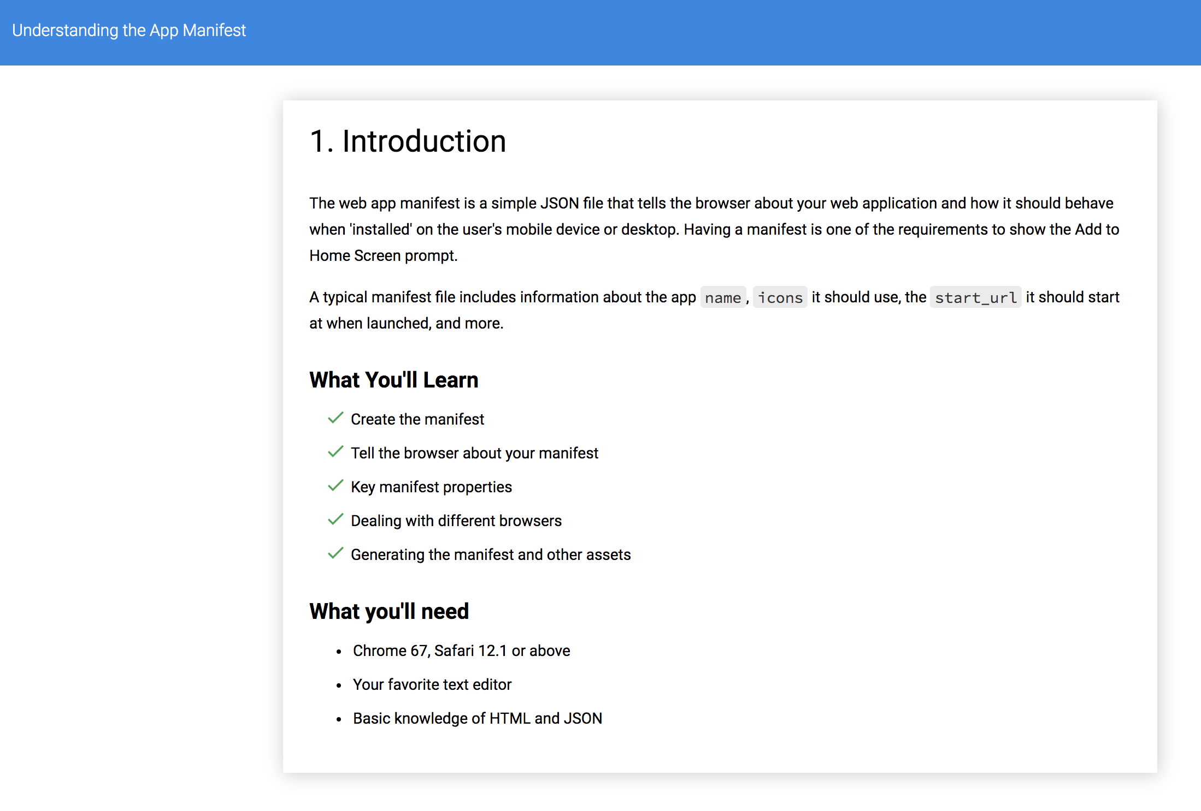

Slide 4
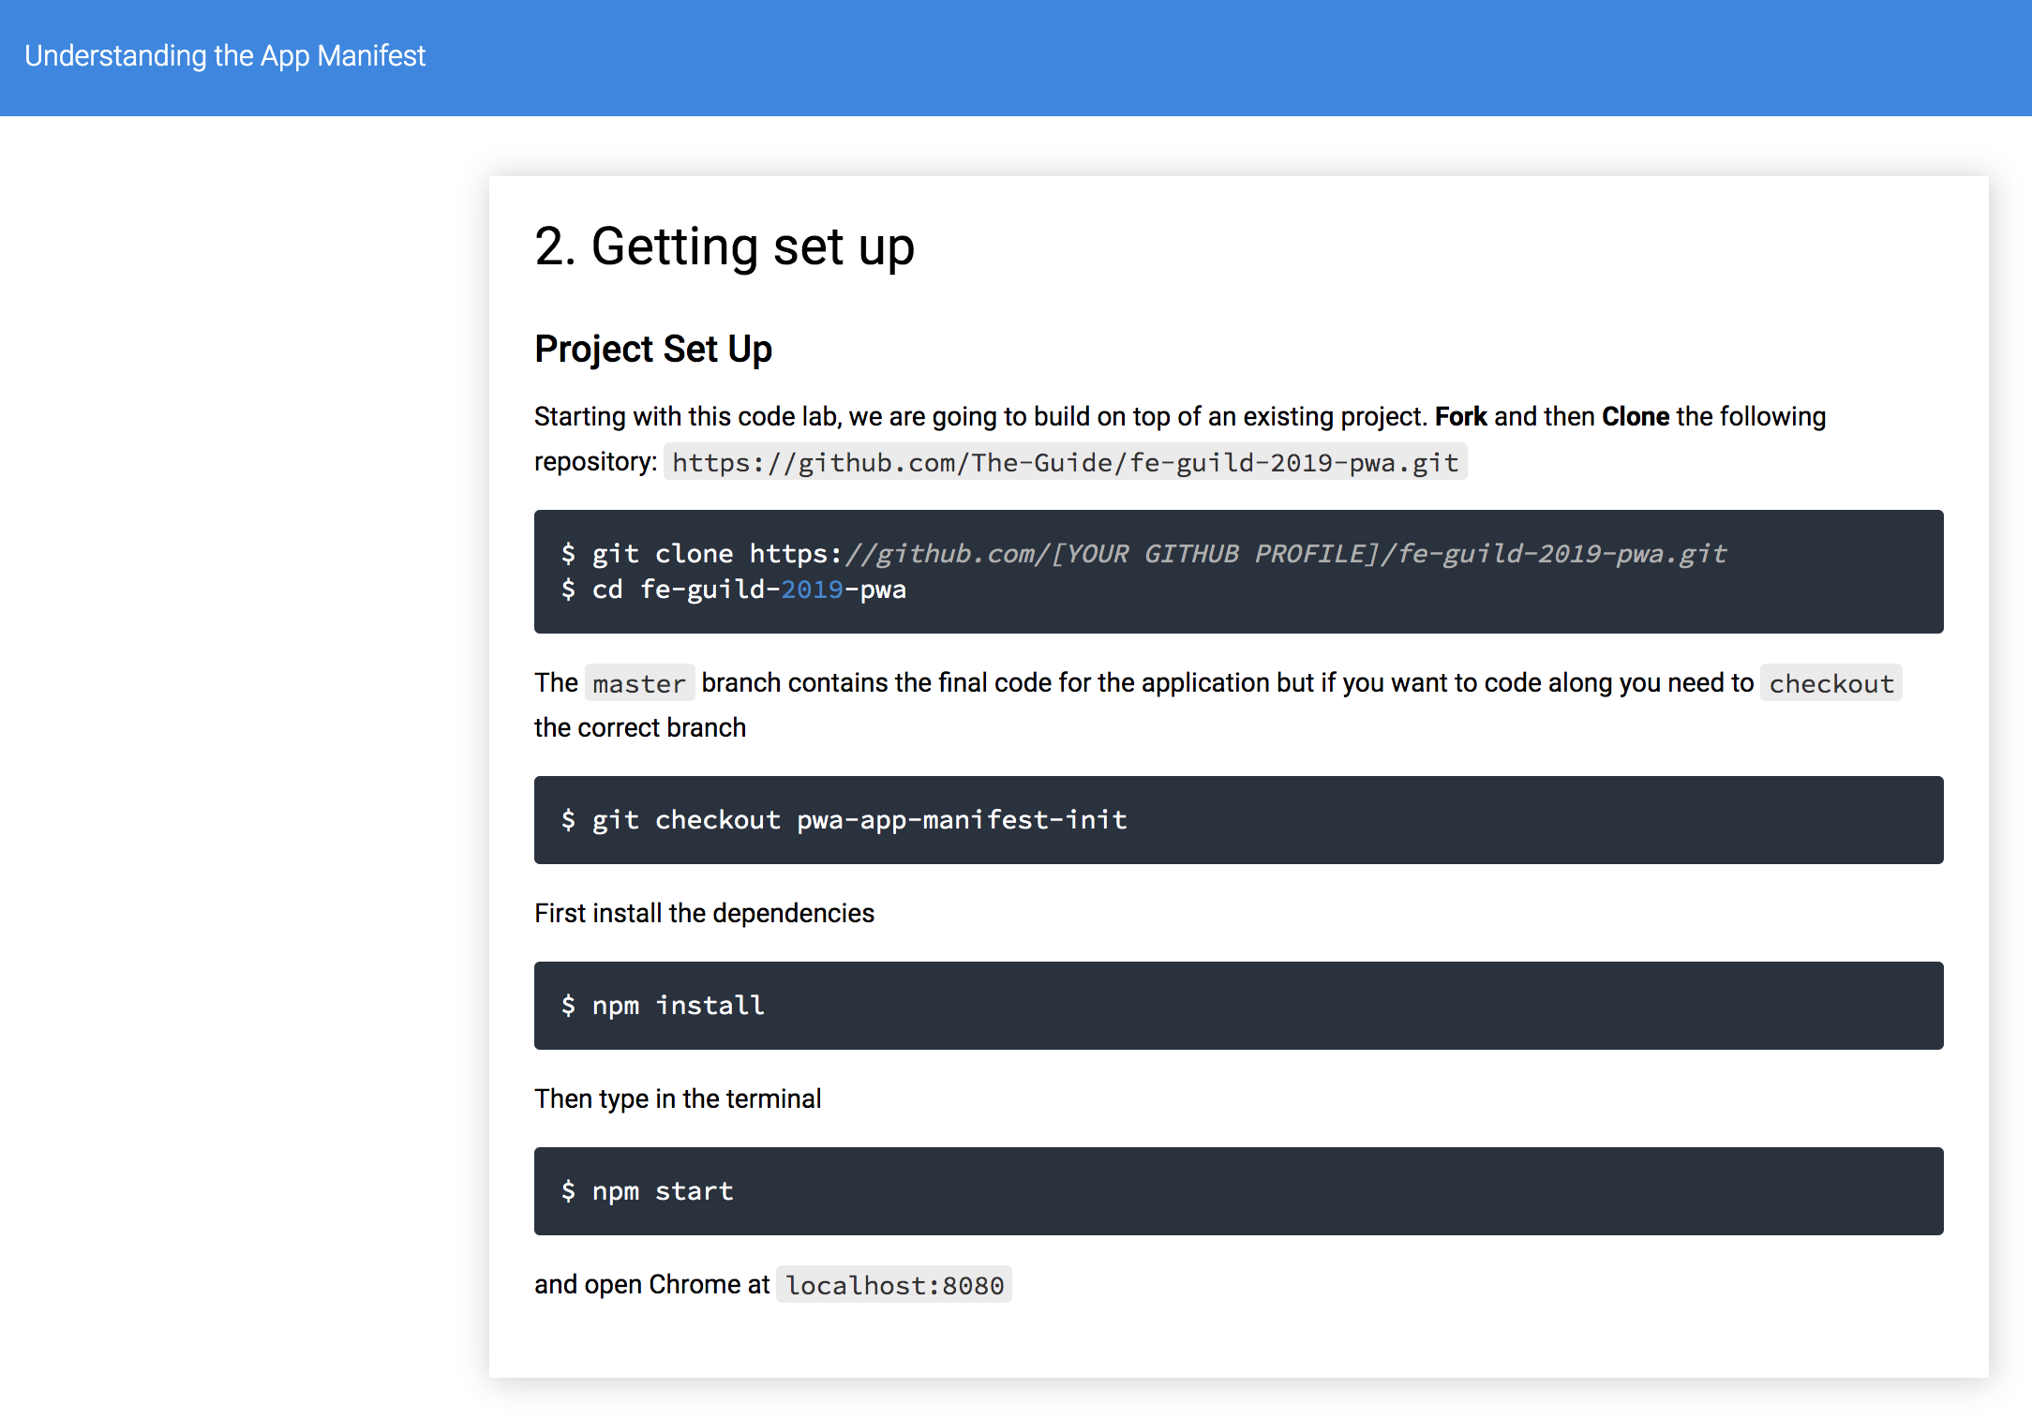
> git clone https://github.com/The-Guide/fe-guild-2019-pwa
> cd fe-guild-2019-pwa

Slide 5
3. Create the Manifest
Create a manifest.json file in the same folder as index.html. A minimal manifest.json file for a progressive web app.
{
"name": "Progressive Selfies",
"short_name": "PWA Selfies",
"icons": [
{
"src": "src/images/icons/app-icon-48x48.png",
"type": "image/png",
"sizes": "48x48"
},
{
"src": "src/images/icons/app-icon-512x512.png",
"type": "image/png",
"sizes": "512x512"
}
],
"start_url": "/index.html",
"scope": ".",
"display": "standalone",
"orientation": "portrait-primary",
"background_color": "#fff",
"theme_color": "#3f51b5",
"description": "Take selfies PWA style.",
"dir": "ltr",
"lang": "en-US"
}
Tell the browser about your manifest
When you have created the manifest, add a link tag to all the pages that encompass your web app. Add this to your index.html
<link rel="manifest" href="/manifest.json">

Slide 6
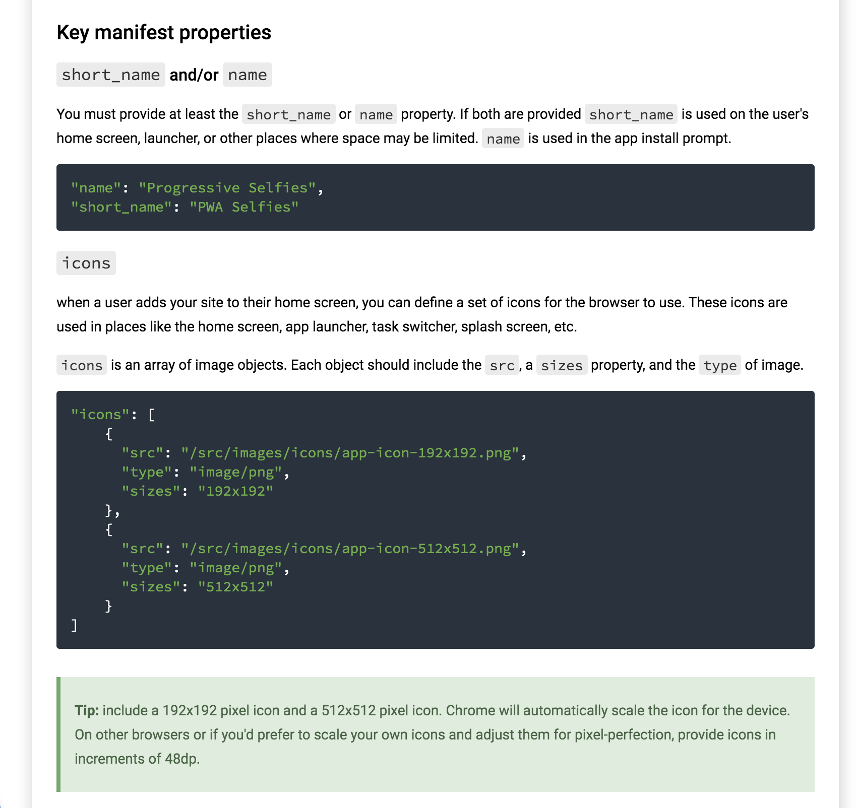

Slide 7
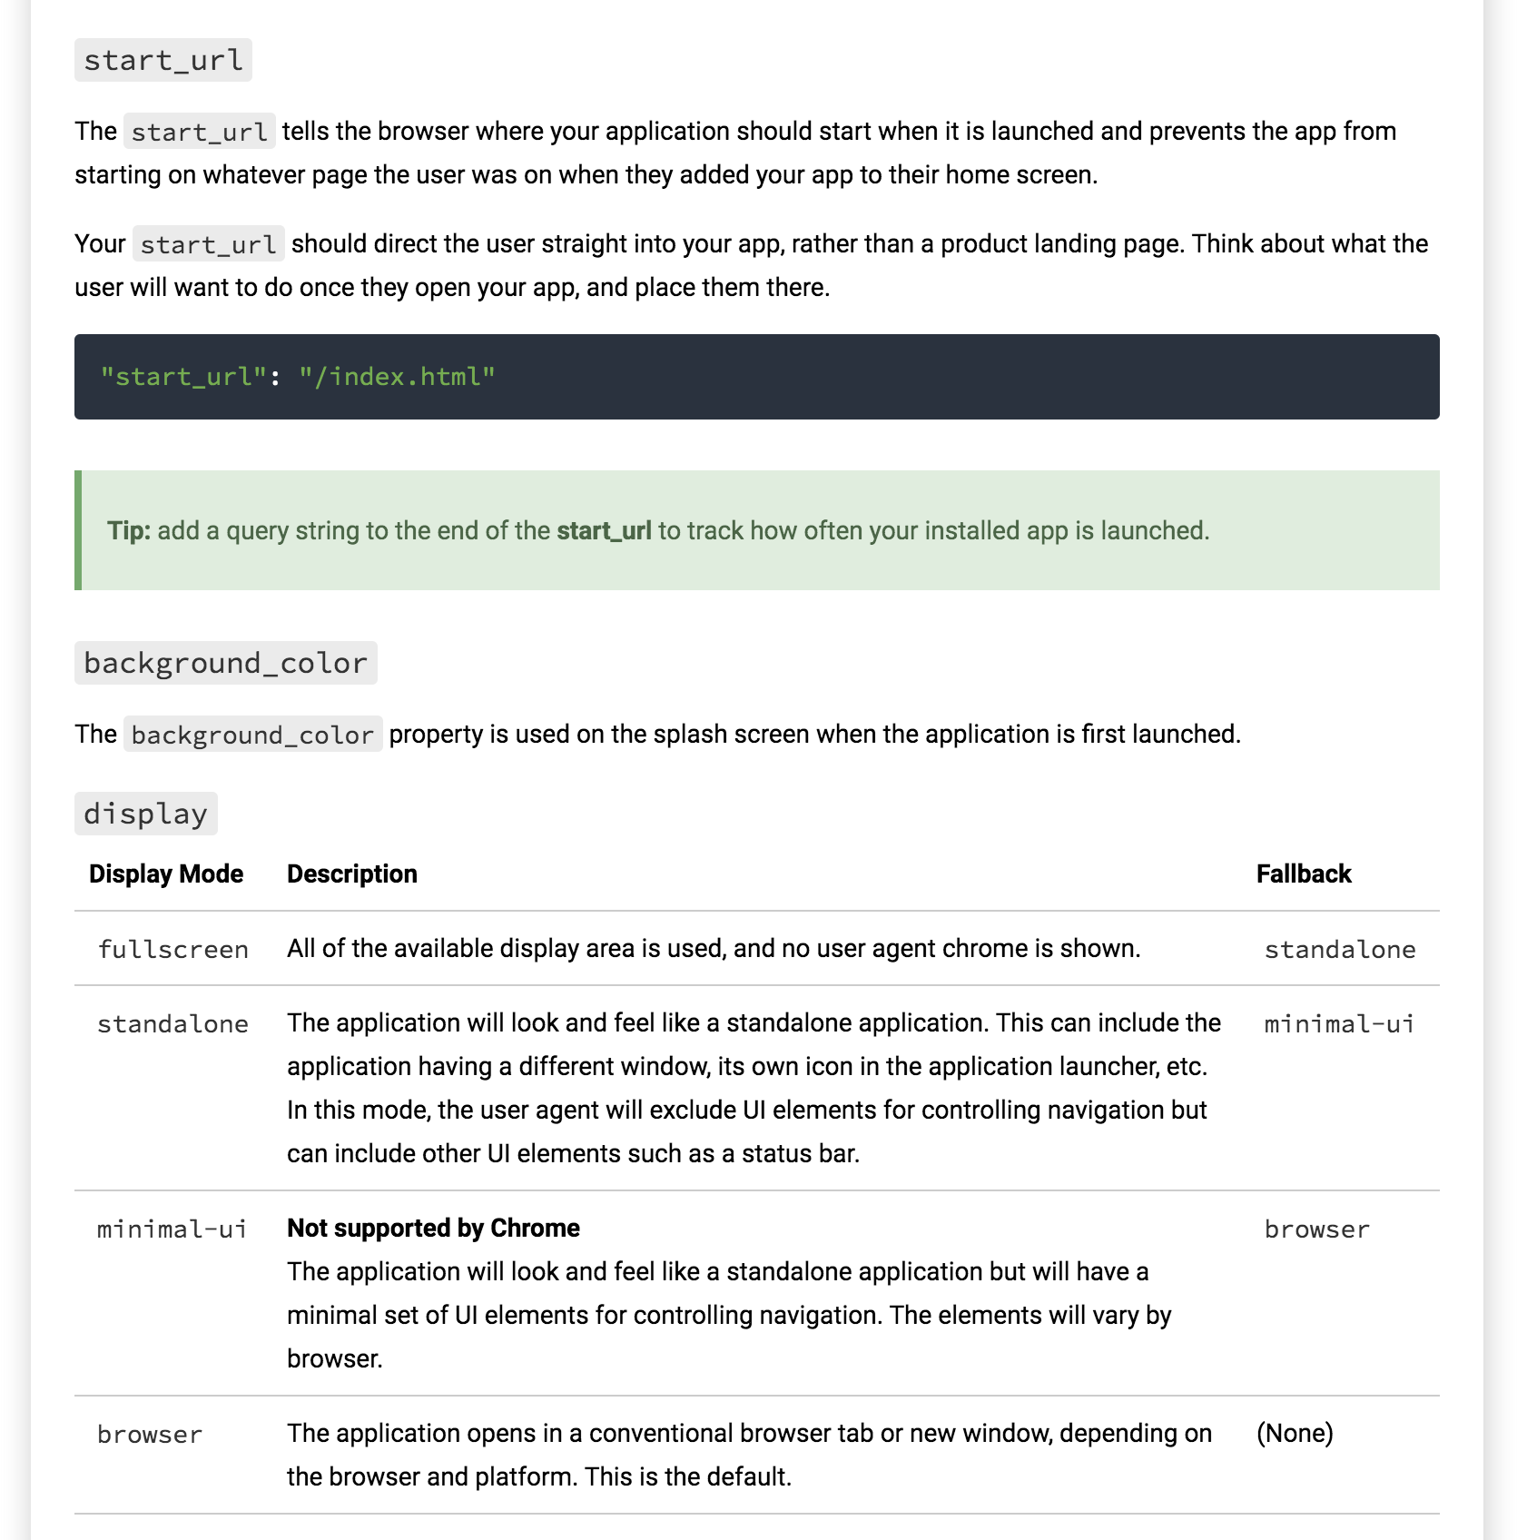

Slide 8
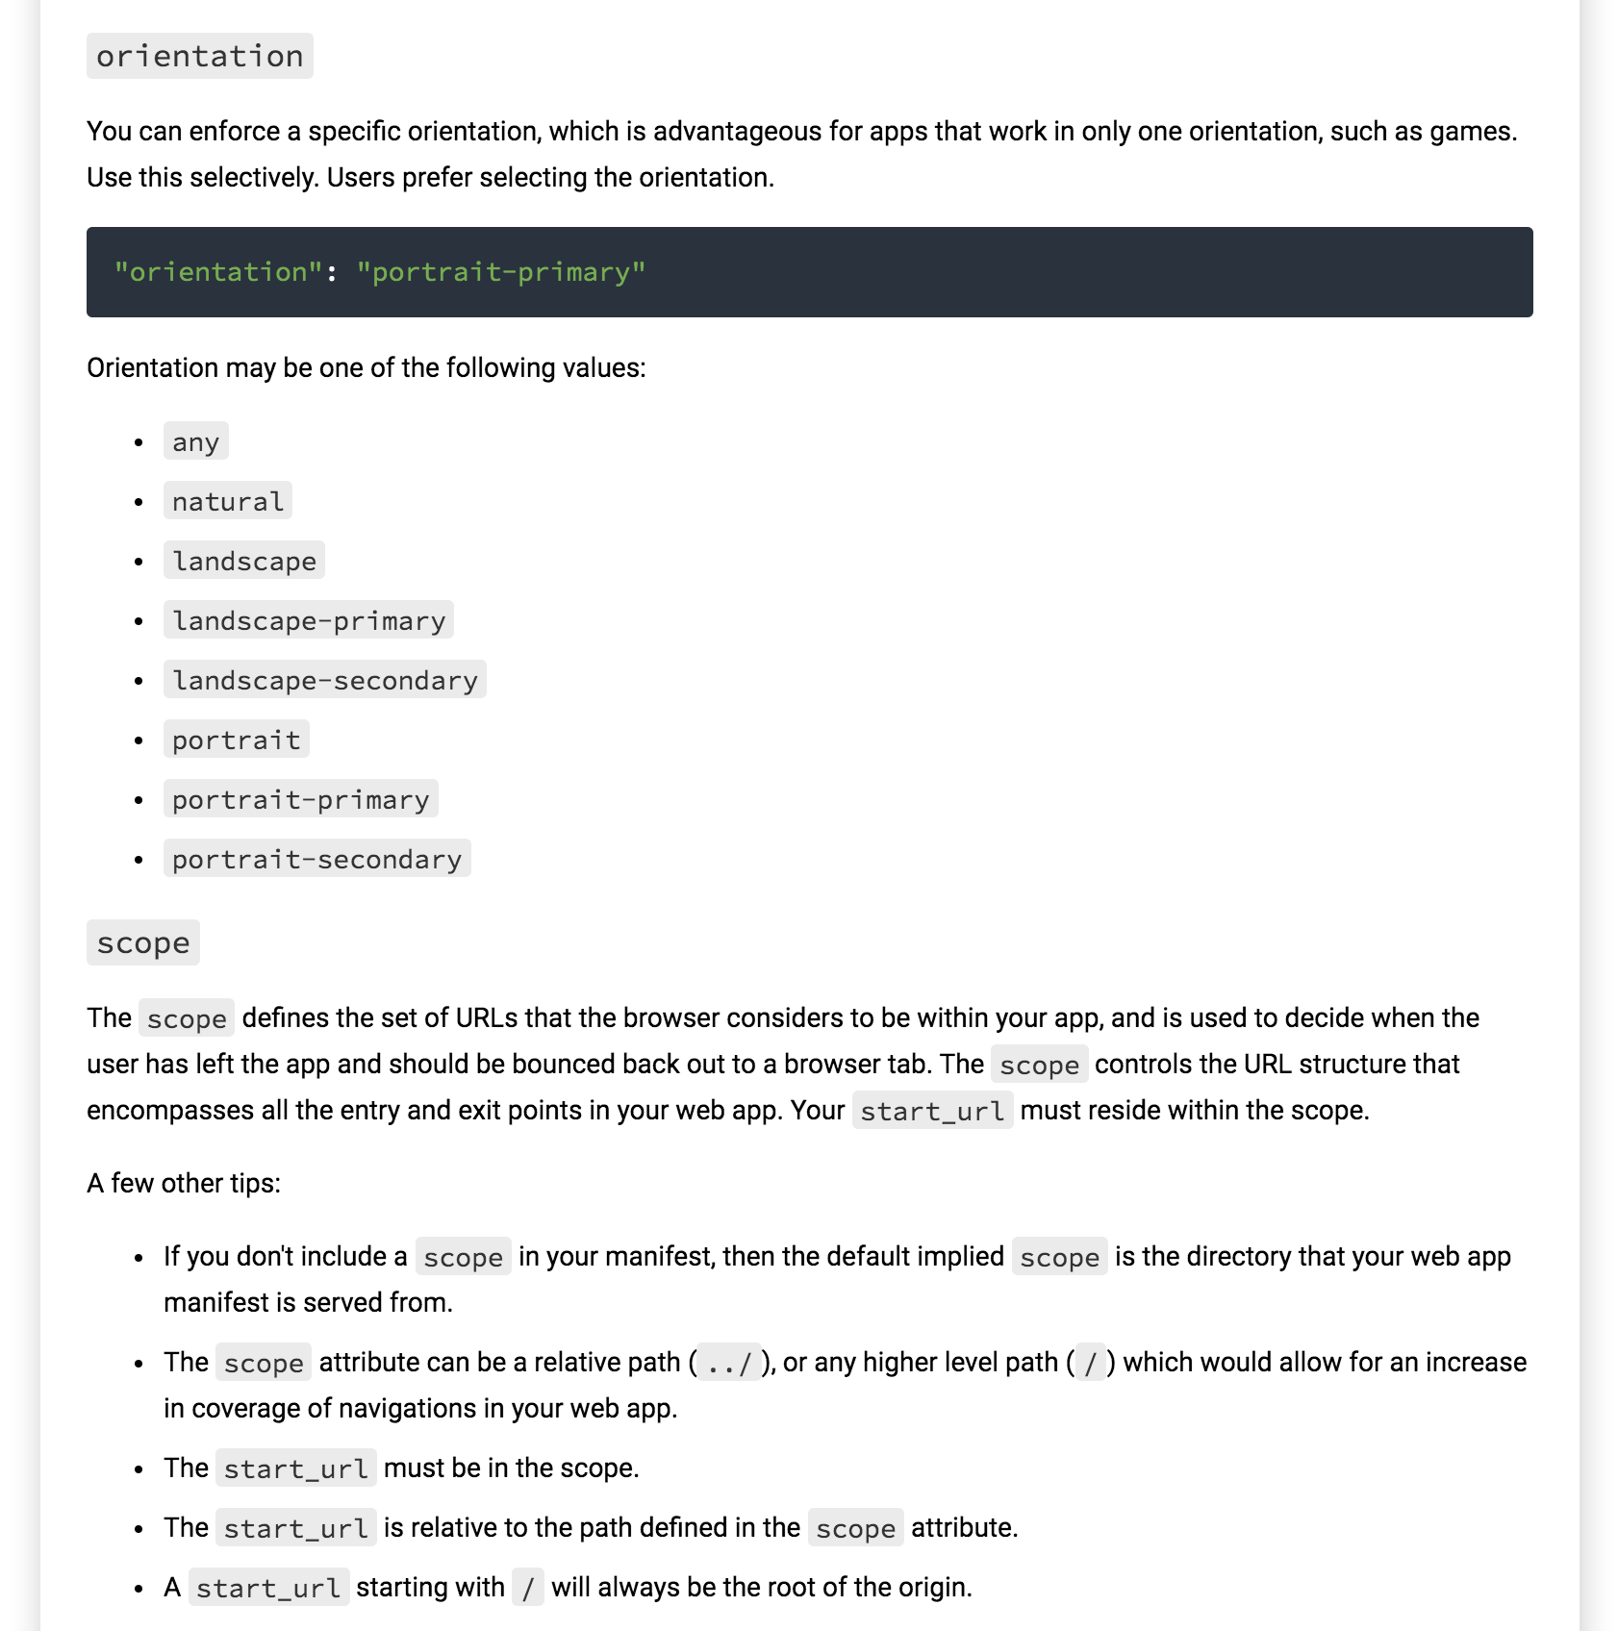

Slide 9
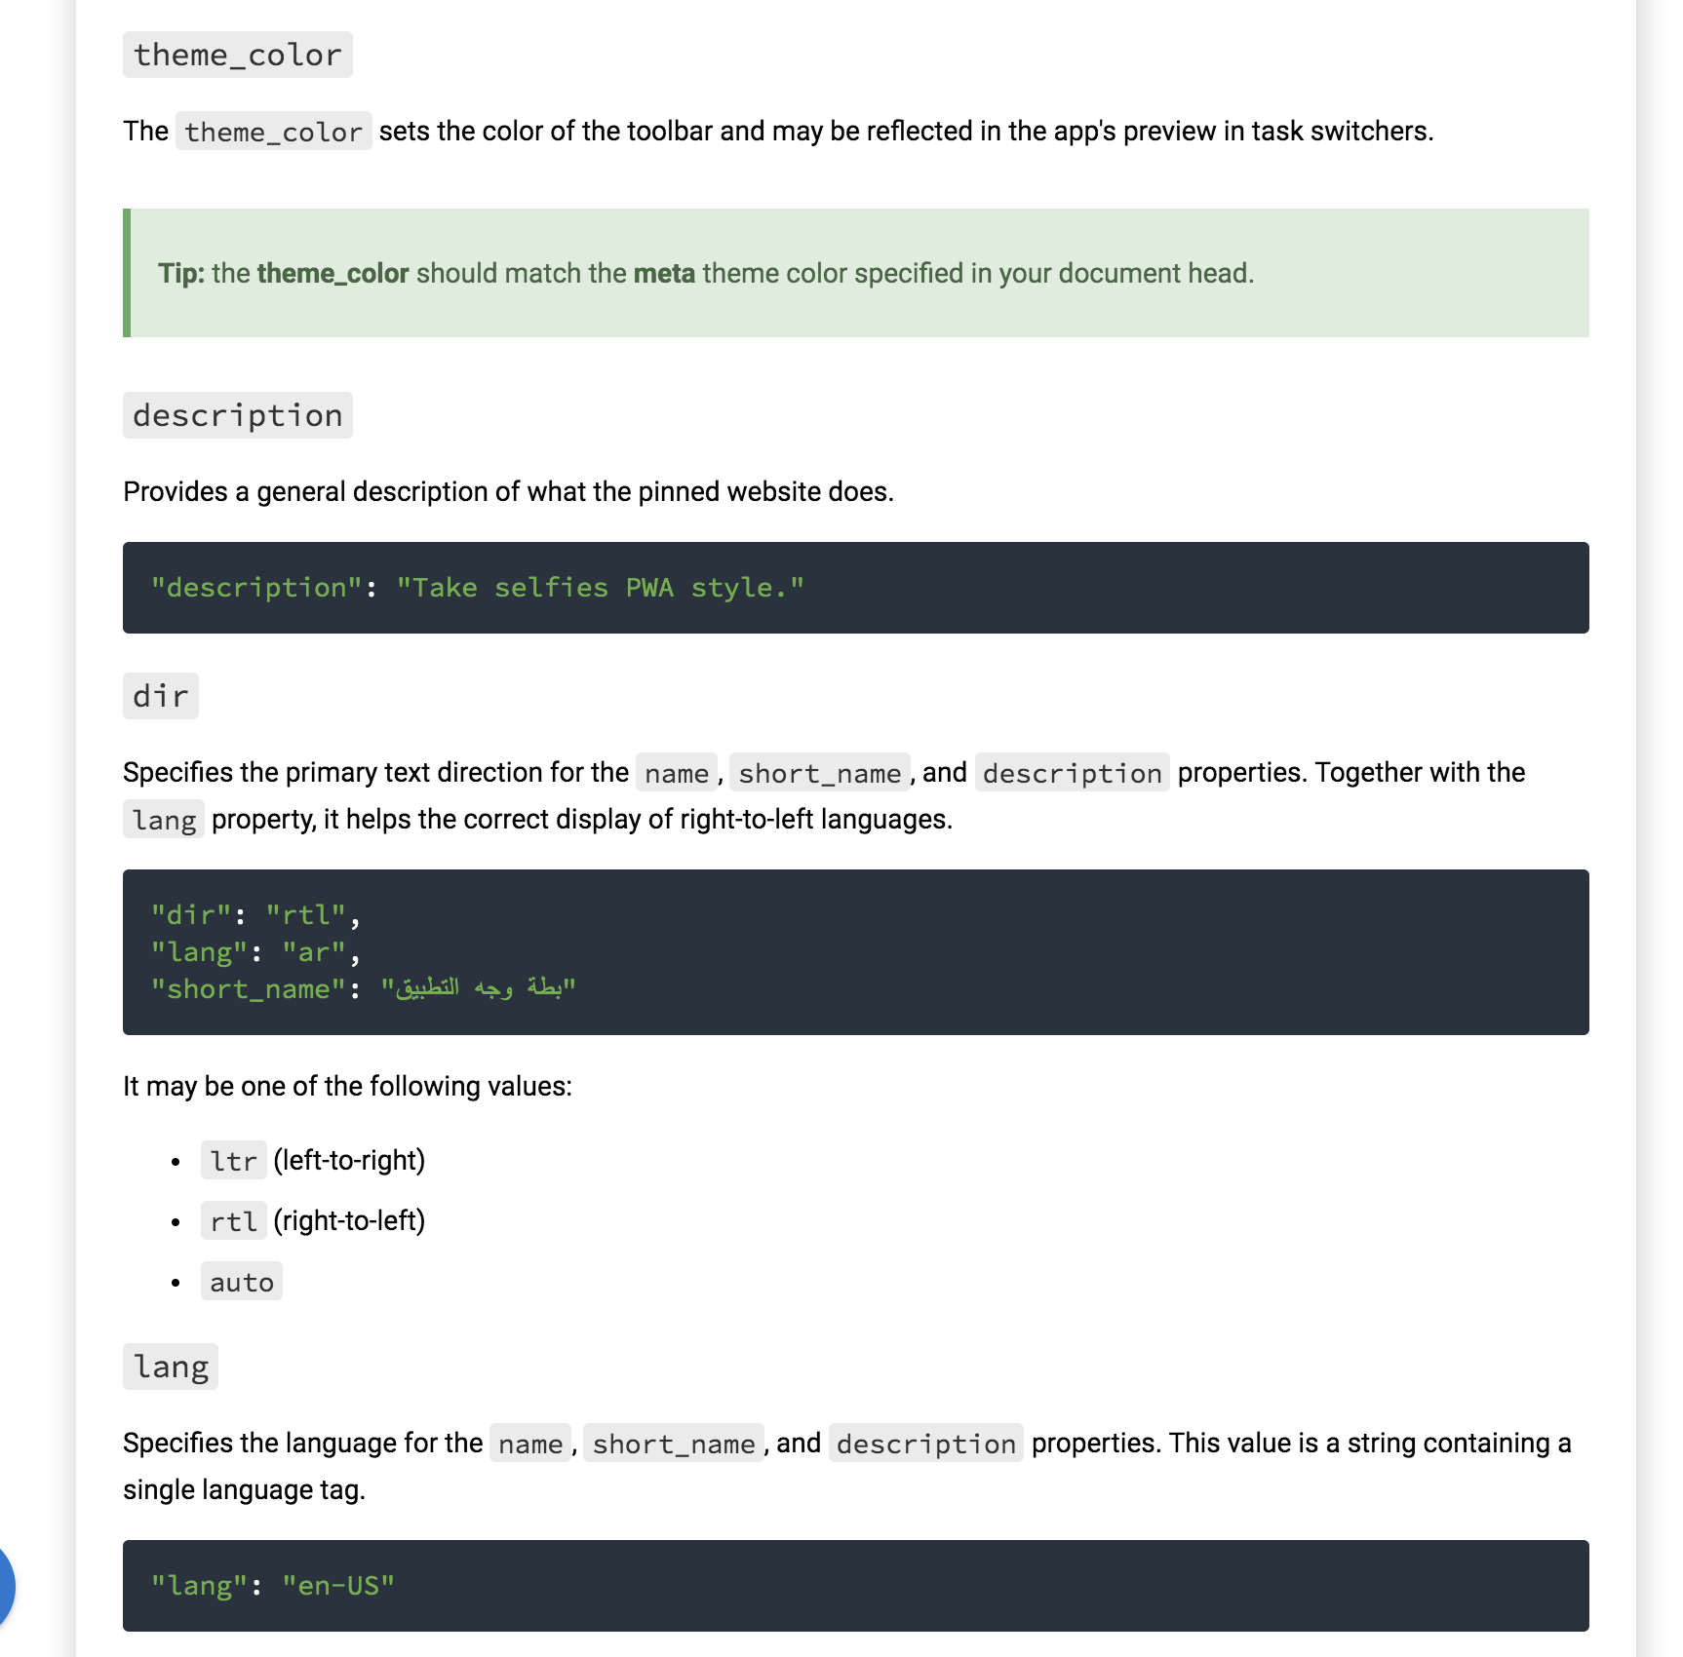

Slide 10
Exercise
Now you can check that the manifest is enabled by opening the Chrome Developer Tools and then:
Application ==> Manifest

Slide 11
Generating the app.manifest assets
Creating the manifest by hand is not a difficult task, but for sure it is not a fun one. You can use one of the following links to generate the manifest file:
https://pwafire.org/developer/tools/get-manifest/
https://app-manifest.firebaseapp.com/
Optional: https://www.pwabuilder.com/
Exercise: Use one of the builders to build a manifest file

Slide 12
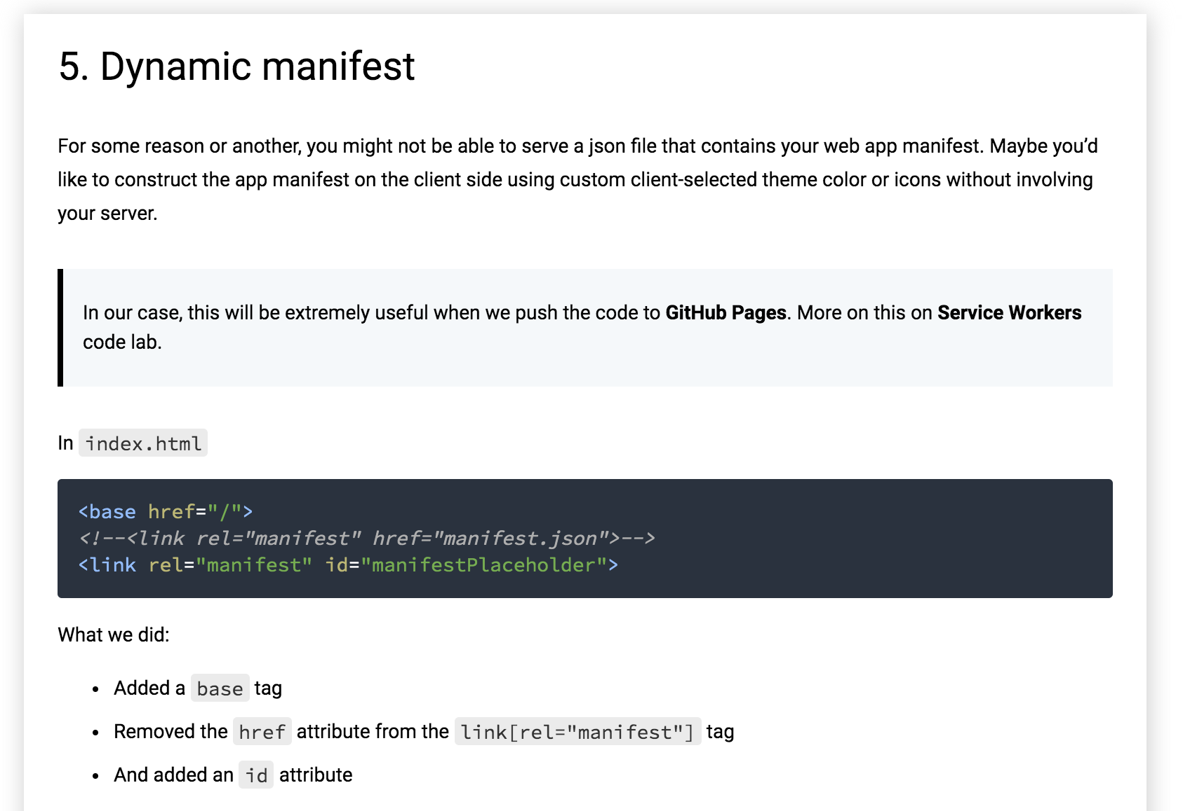

Slide 13
Add this in app.js
const manifest = { ... };
// Replace { ... } with the content of the manifest.json file and remove the "start_url" and "scope” !!!
window.addEventListener('load', () => {
const base = document.querySelector('base');
let baseUrl = base && base.href || '';
if (!baseUrl.endsWith('/')) {
baseUrl = `${baseUrl}/`;
}
manifest['start_url'] = `${baseUrl}index.html`;
manifest.icons.forEach(icon => {
icon.src = `${baseUrl}${icon.src}`;
});
const stringManifest = JSON.stringify(manifest);
const blob = new Blob([stringManifest], {type: 'application/json'});
const manifestURL = URL.createObjectURL(blob);
document.querySelector('#manifestPlaceholder').setAttribute('href', manifestURL);
});

Slide 14
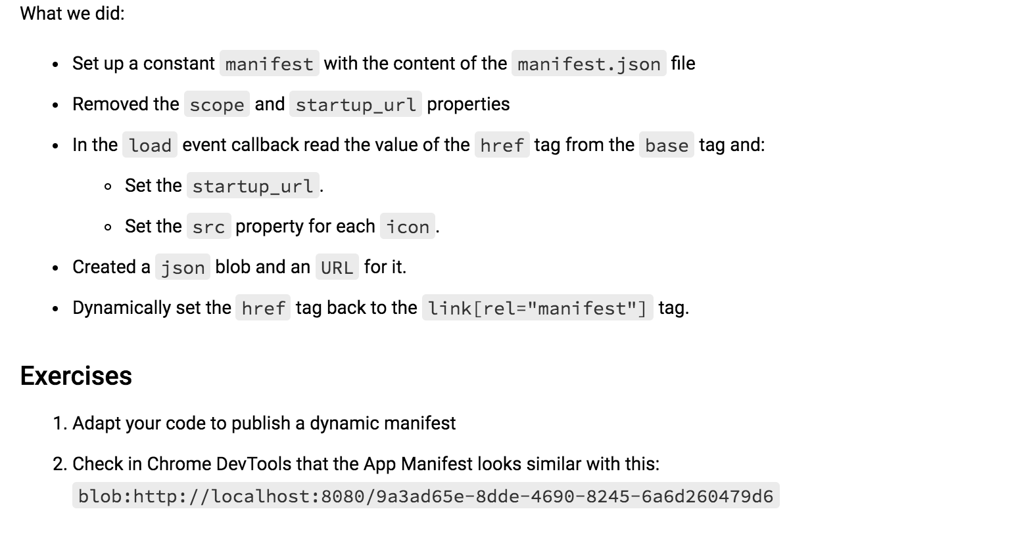

Slide 15
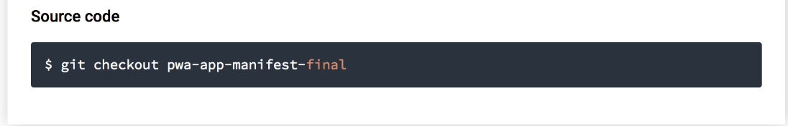
Solution

Slide 16
Introduction to
Service Workers

Slide 17
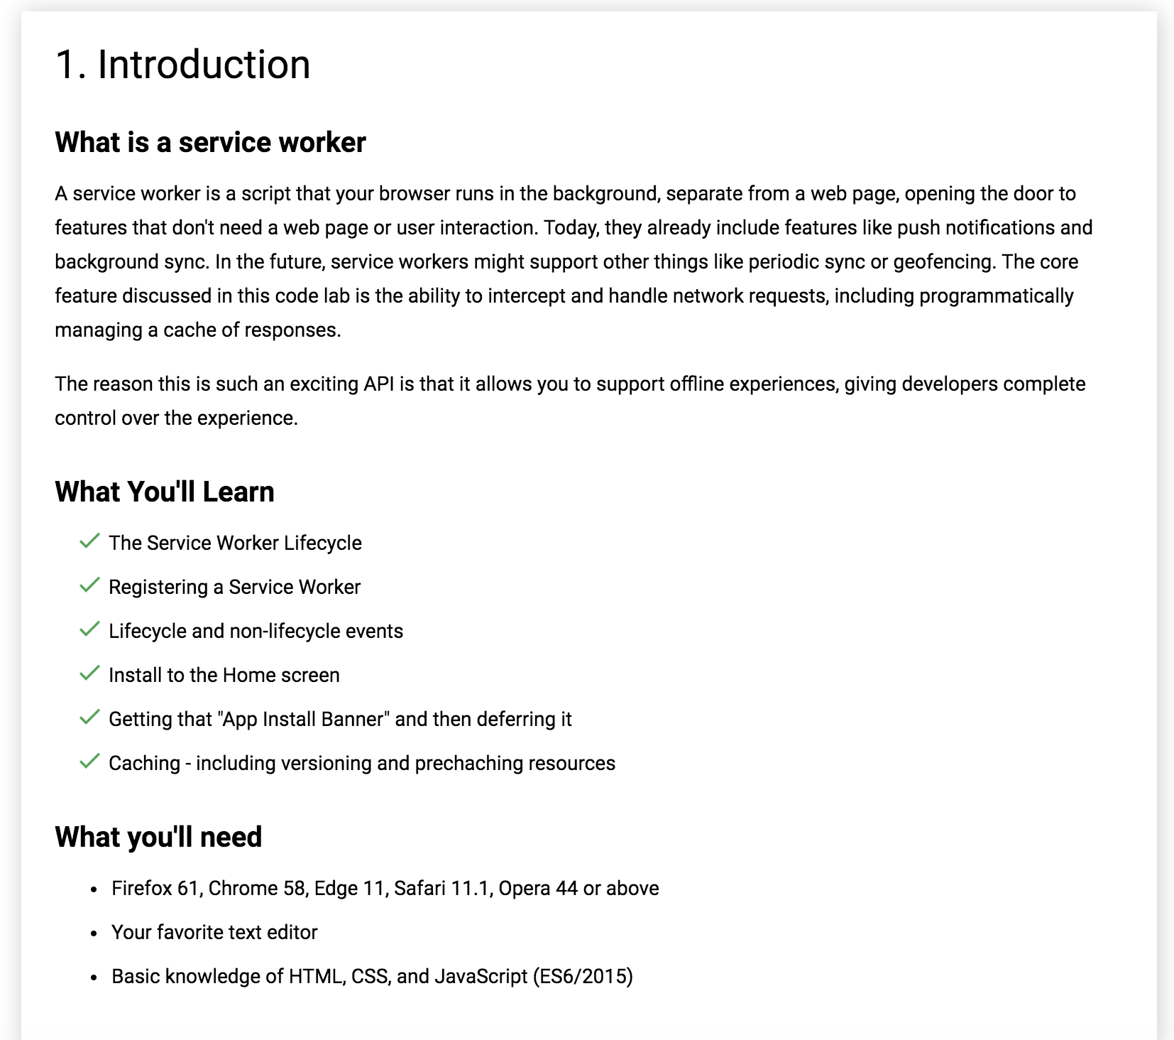

Slide 18
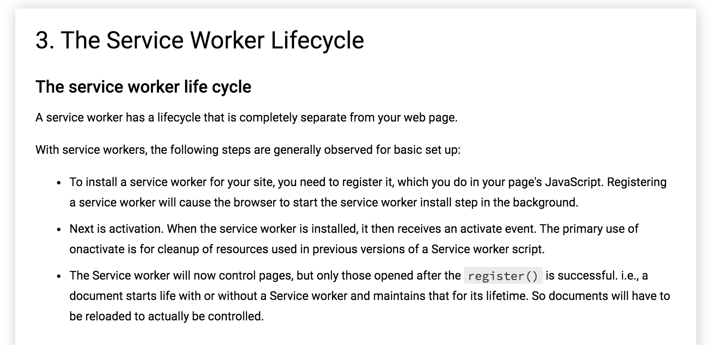

Slide 19
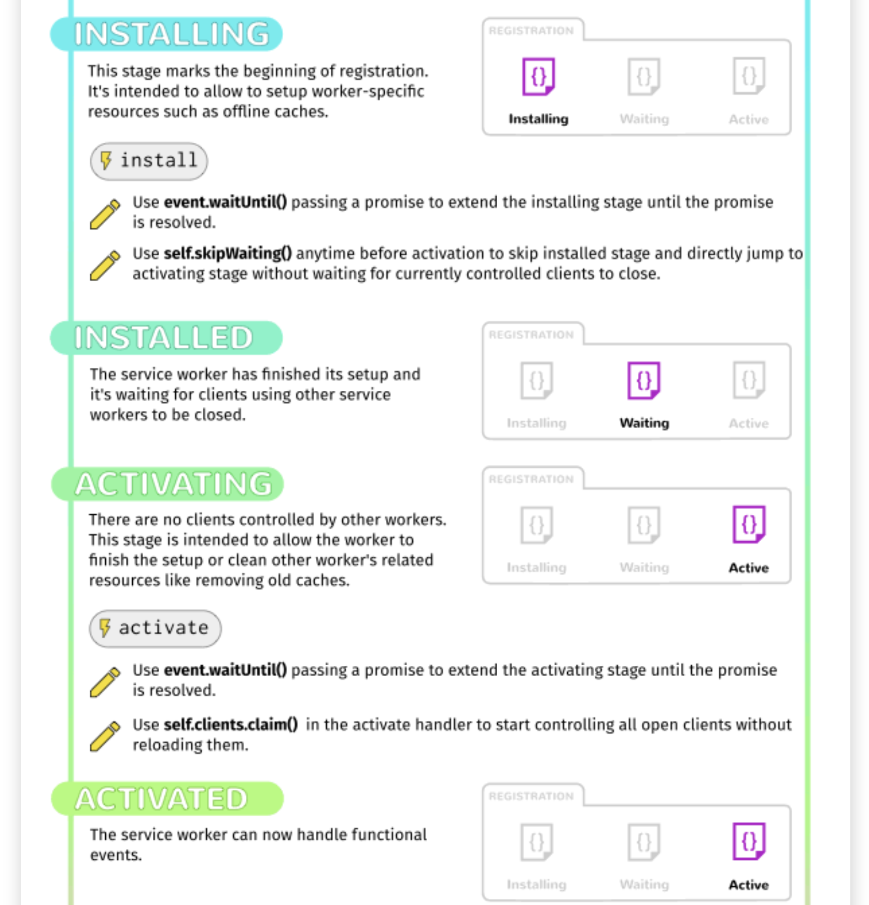
Service Worker Lifecycle

Slide 20
Register a Service Worker in sw.js
To install a service worker, you need to kick start the process by registering it on your page. This tells the browser where your service worker JavaScript file lives. Create an empty file named sw.js on the same level as index.html. Then in src/js/app.js add this:
window.addEventListener('load', () => {
// Place this code after the existing code !!!
if ('serviceWorker' in navigator) {
navigator.serviceWorker.register(`${baseUrl}sw.js`)
.then( registration => {
// Registration was successful
console.log('ServiceWorker registration successful with scope: ', registration.scope);
})
.catch(err => {
// registration failed :(
console.log('ServiceWorker registration failed: ', err);
});
}
});

Slide 21
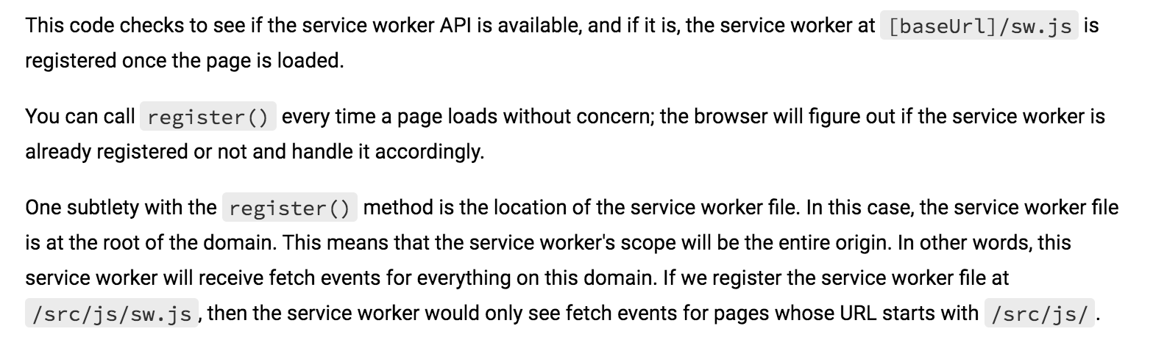

Slide 22
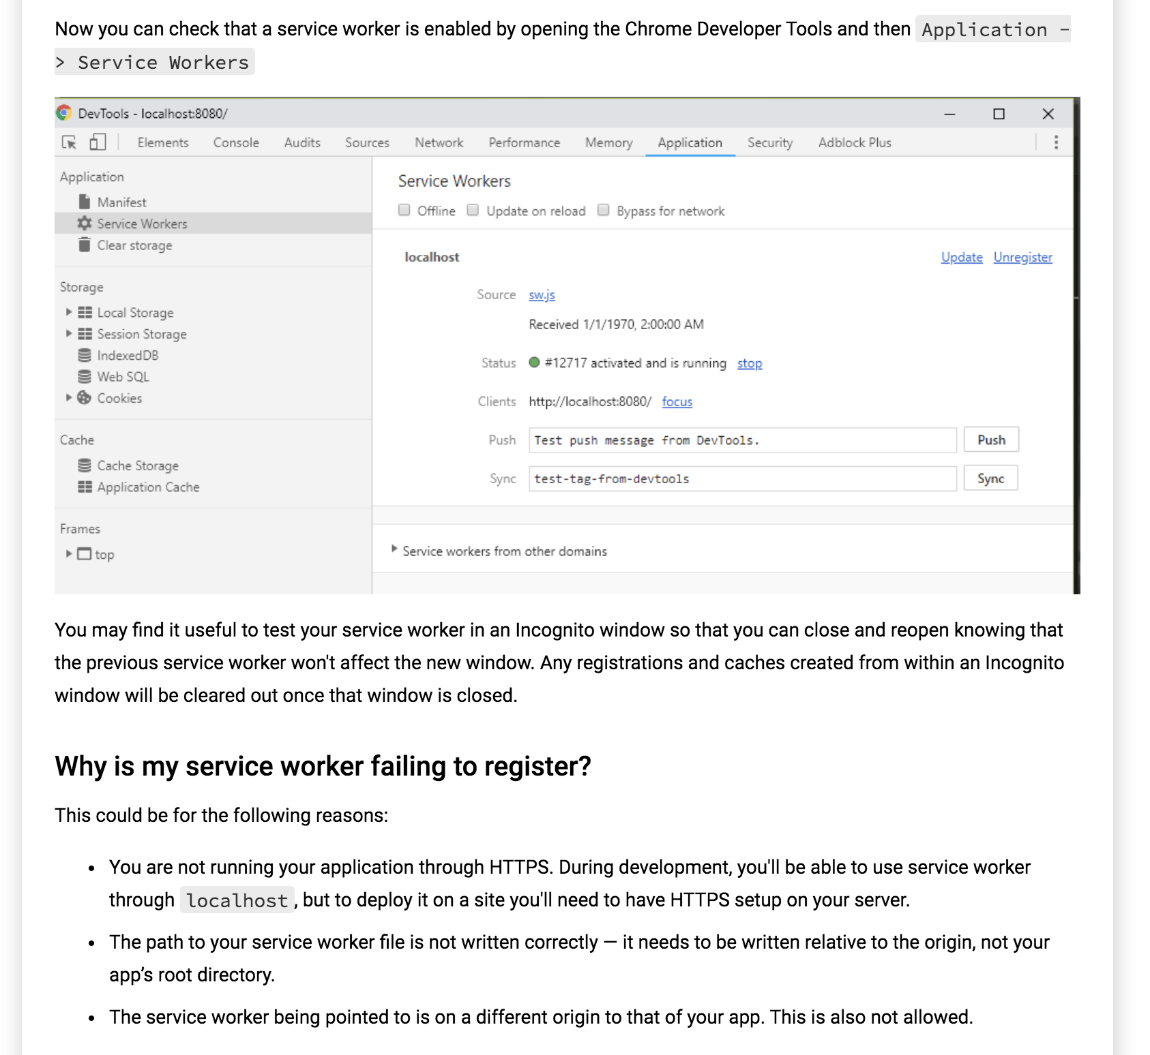

Slide 23
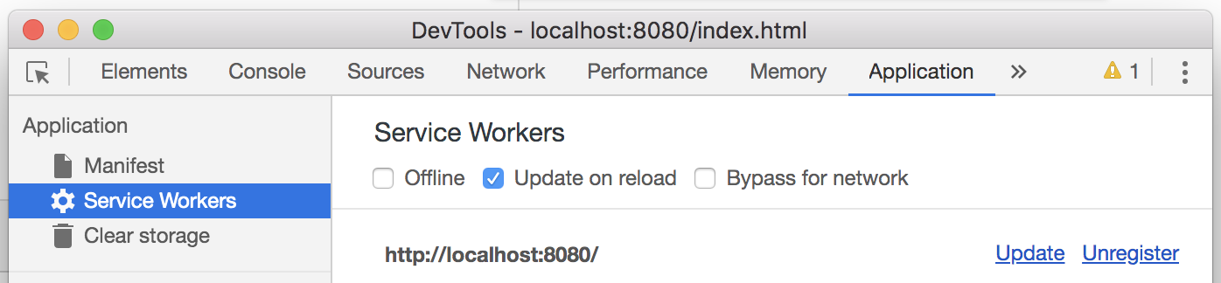
And always ‘update on reload’ your Service worker, during development !!!

Slide 24
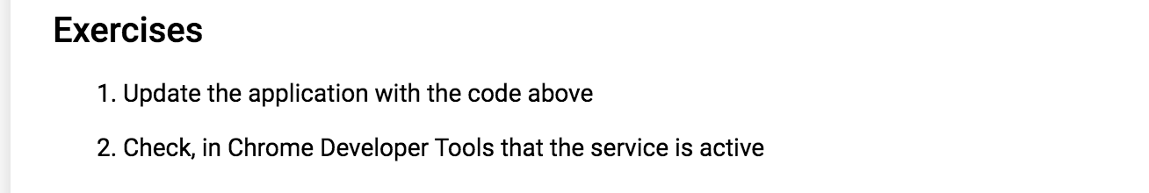

Slide 25
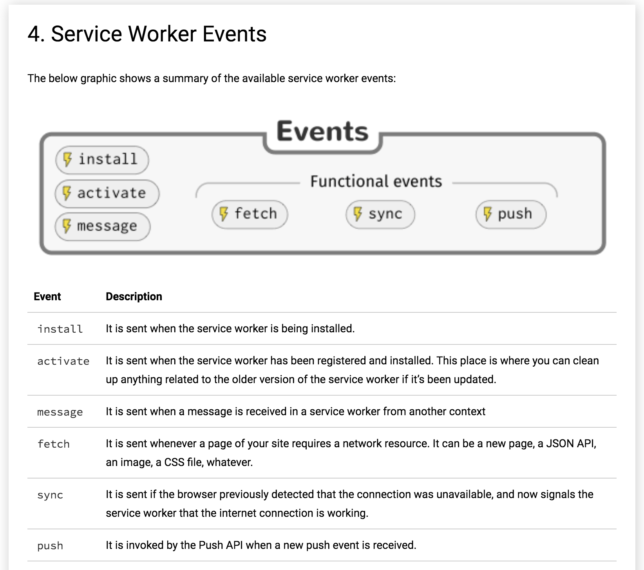

Slide 26
Add this in sw.js
Let's listen to the main lifecycle events install and activate
Add this in the sw.js:
self.addEventListener('install', event => {
console.log('[Service Worker] Installing Service Worker ...', event);
event.waitUntil(self.skipWaiting());
});
self.addEventListener('activate', event => {
console.log('[Service Worker] Activating Service Worker ...', event);
return self.clients.claim();
});

Slide 27
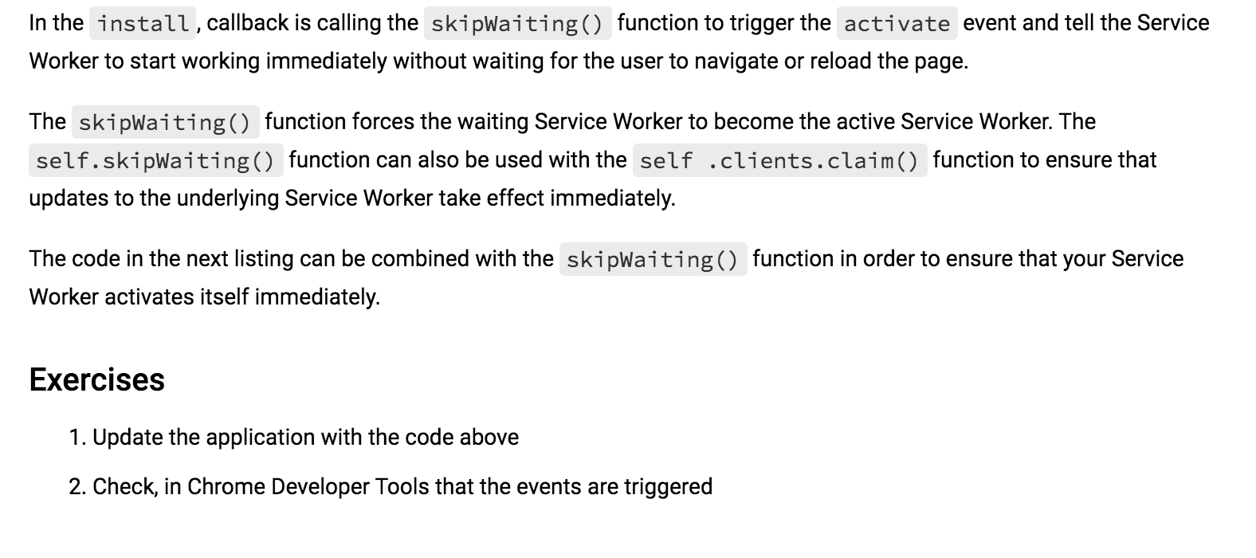

Slide 28
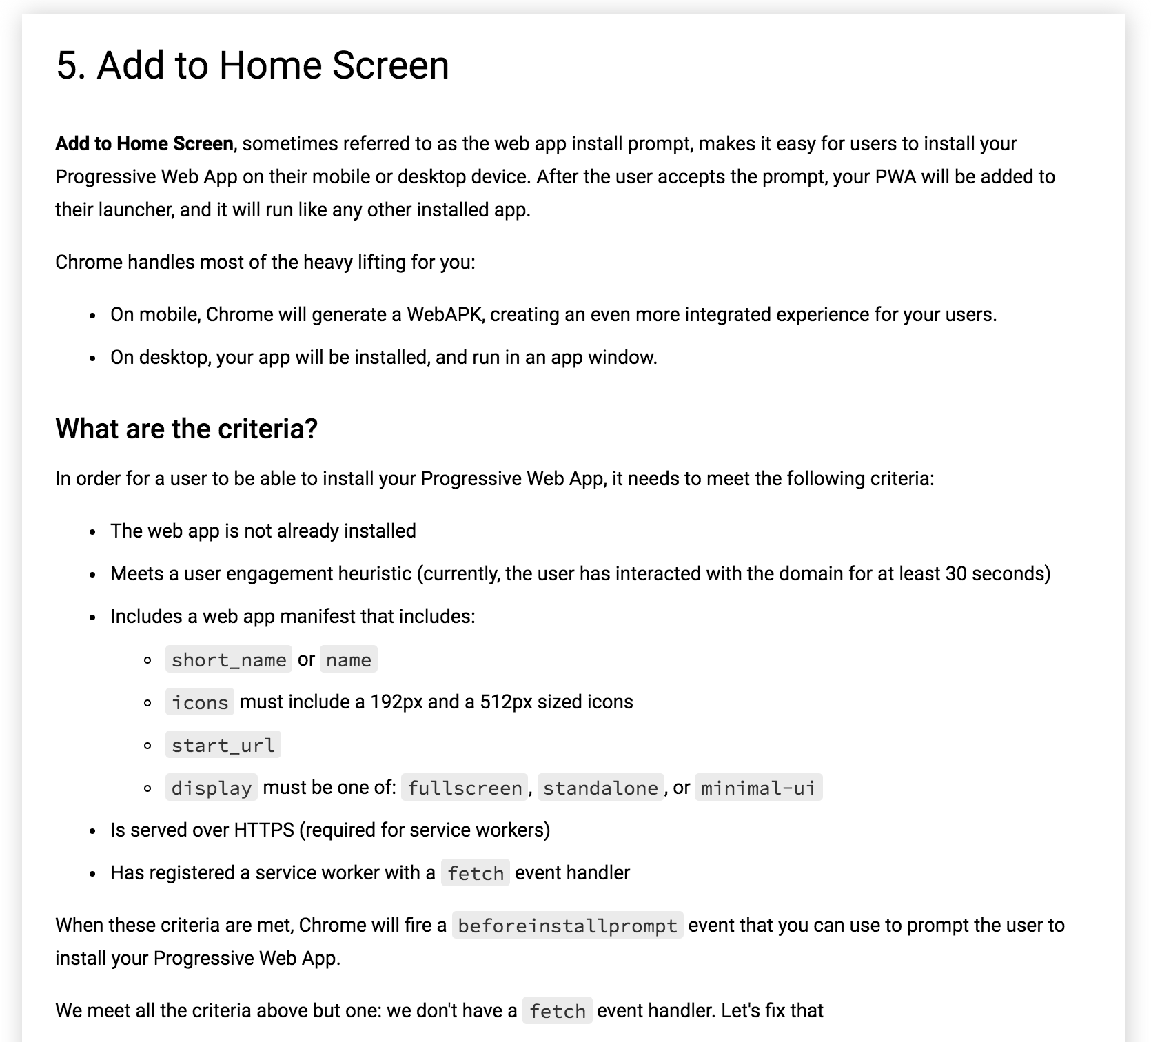

Slide 29
Add this in sw.js
self.addEventListener('fetch', event => {
console.log('[Service Worker] Fetching something ....', event);
// This fixes a weird bug in Chrome when you open the Developer Tools
if (event.request.cache === 'only-if-cached' && event.request.mode !== 'same-origin') {
return;
}
event.respondWith(fetch(event.request));
});
If multiple "fetch events" in SW.js, the first "fetch event" is always used.
So always use only 1 fetch event in the SW.js

Slide 30
Unregister your SW in Chrome Dev tools and refresh your screen
And always ‘update on reload’ your Service worker, during development !!!

Slide 31
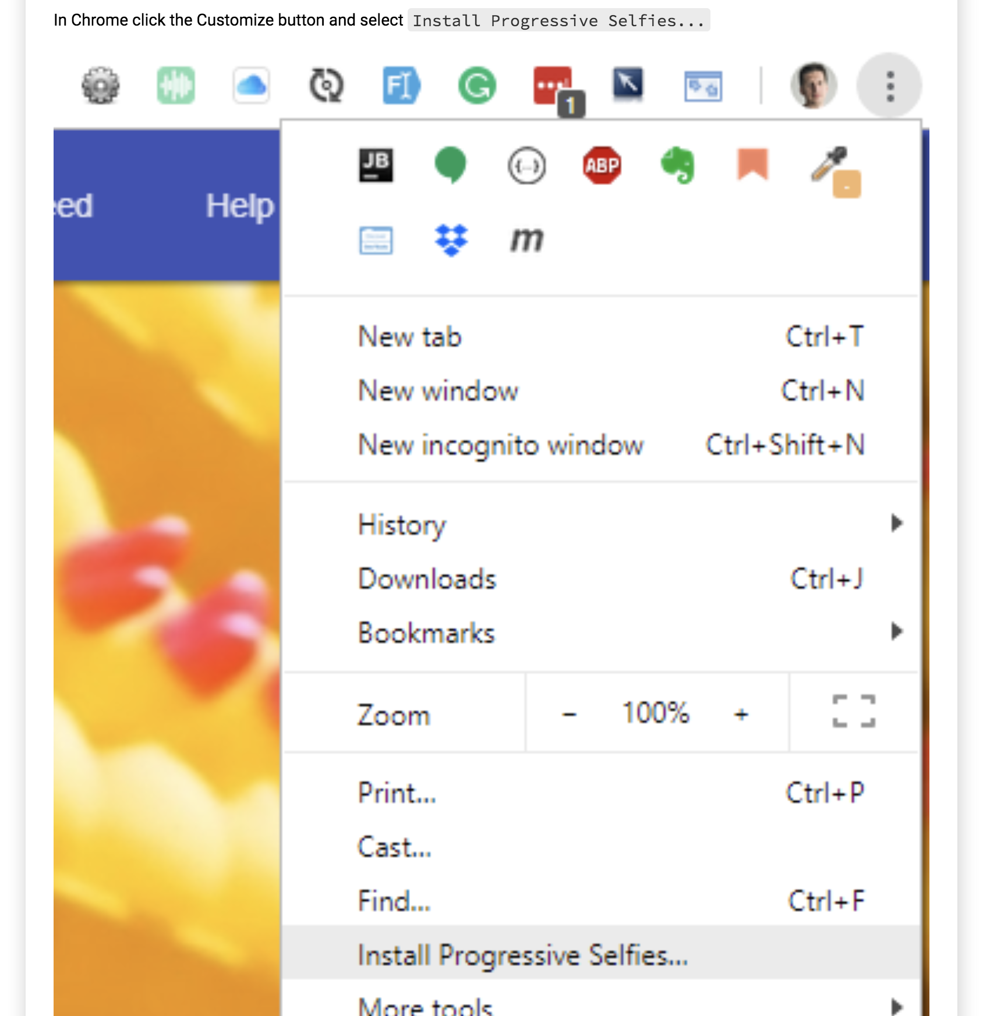

Slide 32
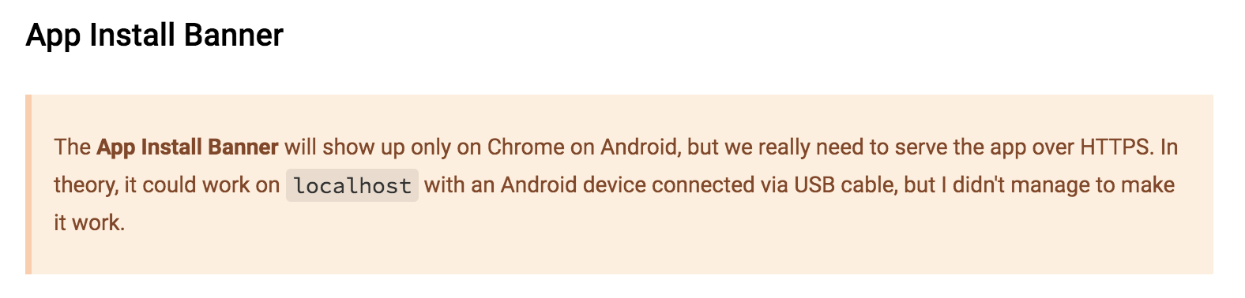

Slide 33
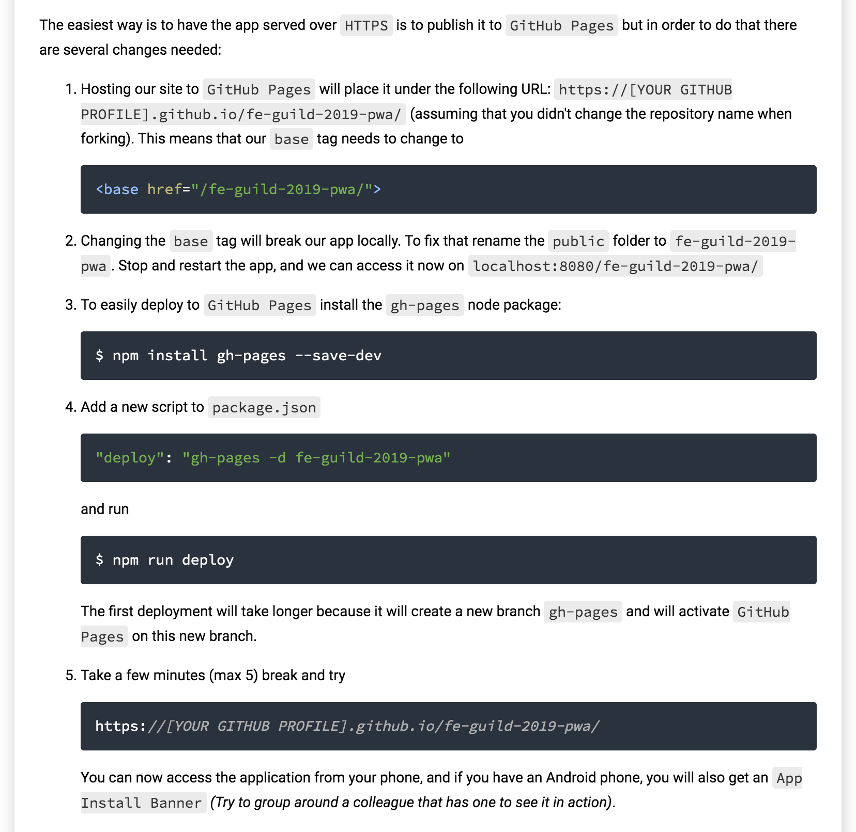
Optional

Slide 34
Exercise
Experiment with the code in this step
Optional: Deploy the app on GitHub Pages

Slide 35
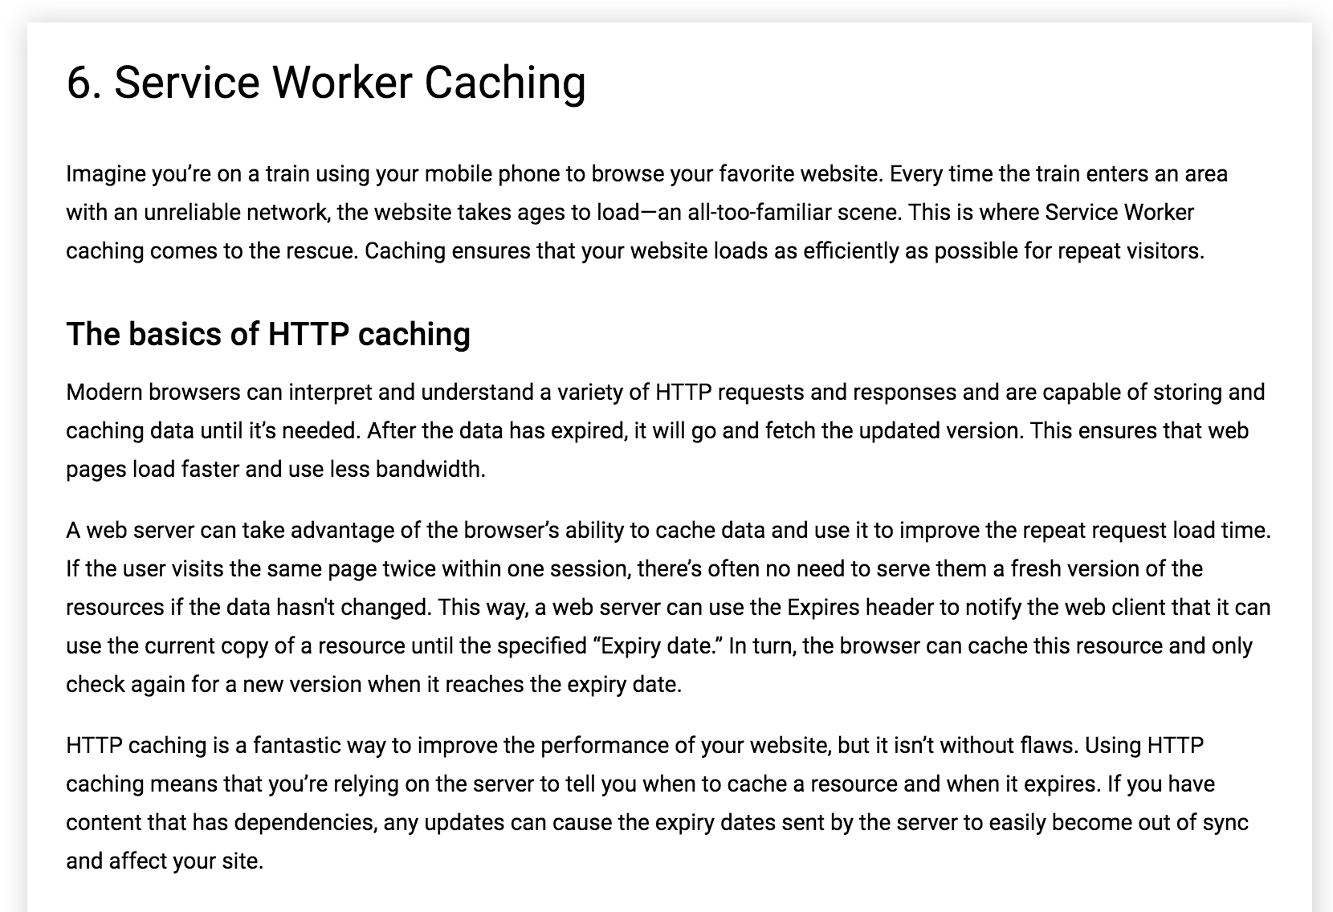

Slide 36
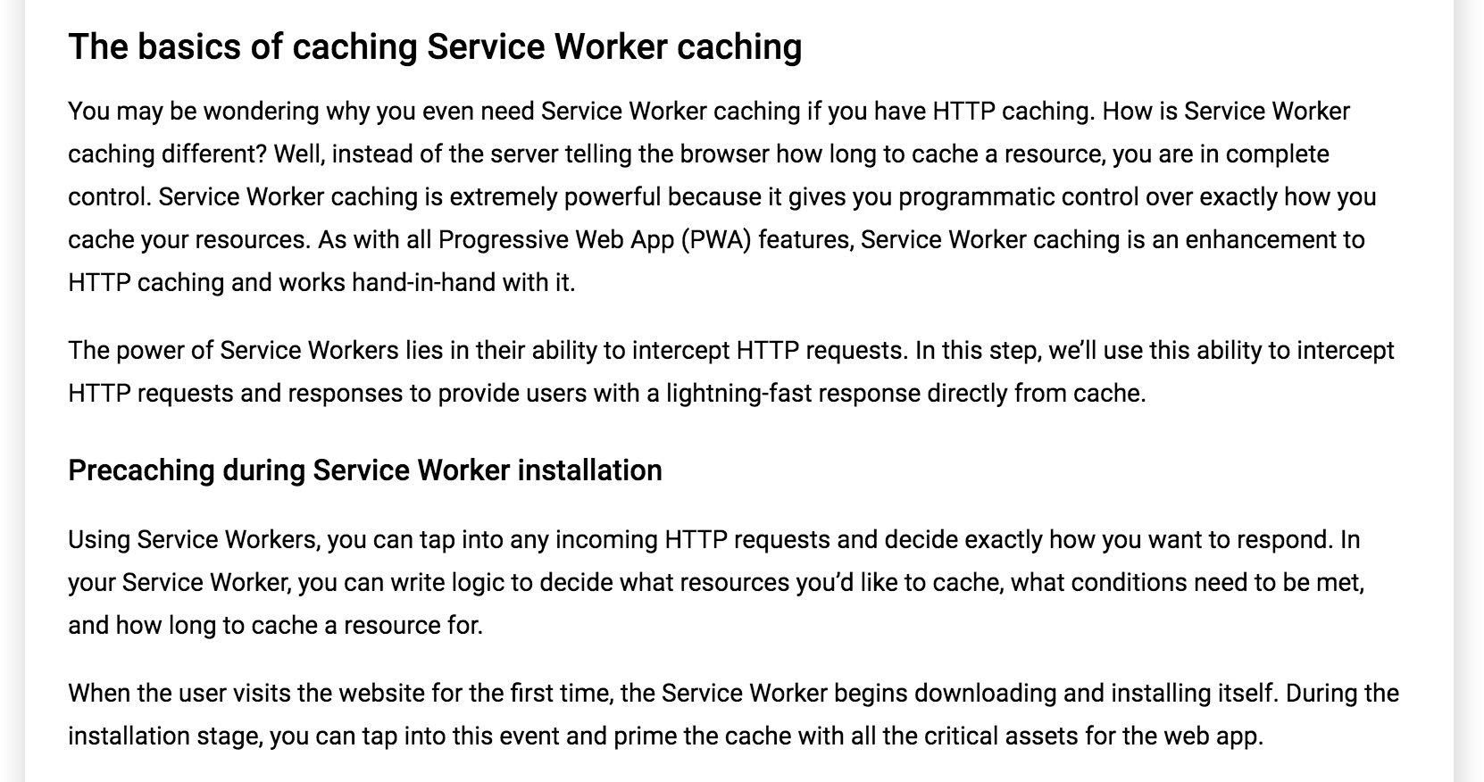

Slide 37
Add this in sw.js
const CACHE_STATIC_NAME = 'static';
const URLS_TO_PRECACHE = [
'/',
'index.html',
'src/js/app.js',
'src/js/feed.js',
'src/lib/material.min.js',
'src/css/app.css',
'src/css/feed.css',
'src/images/main-image.jpg',
'https://fonts.googleapis.com/css?family=Roboto:400,700',
'https://fonts.googleapis.com/icon?family=Material+Icons',
// 'https://code.getmdl.io/1.3.0/material.indigo-deep_orange.min.css"'
];
self.addEventListener('install', event => {
console.log('[Service Worker] Installing Service Worker ...', event);
event.waitUntil(
caches.open(CACHE_STATIC_NAME)
.then(cache => {
console.log('[Service Worker] Precaching App Shell');
cache.addAll(URLS_TO_PRECACHE);
})
.then(() => {
console.log('[ServiceWorker] Skip waiting on install');
return self.skipWaiting();
})
);
});

Slide 38
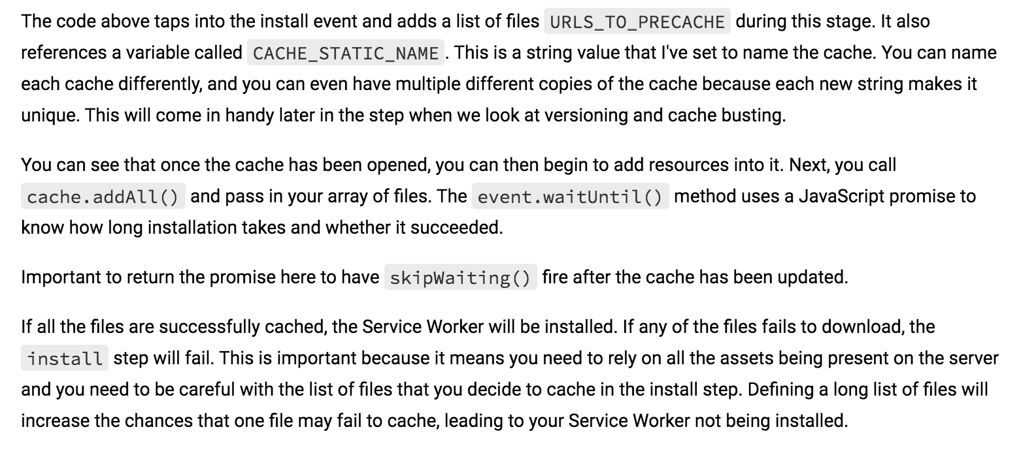

Slide 39
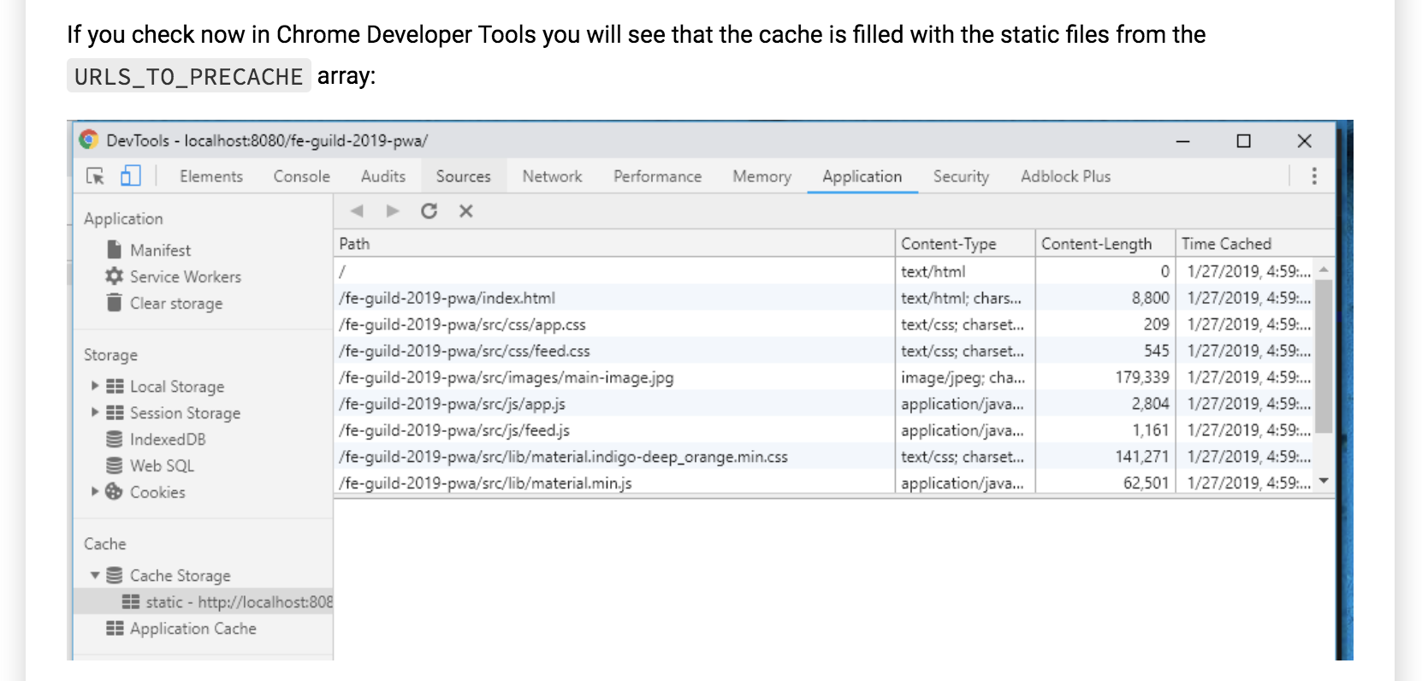

Slide 40
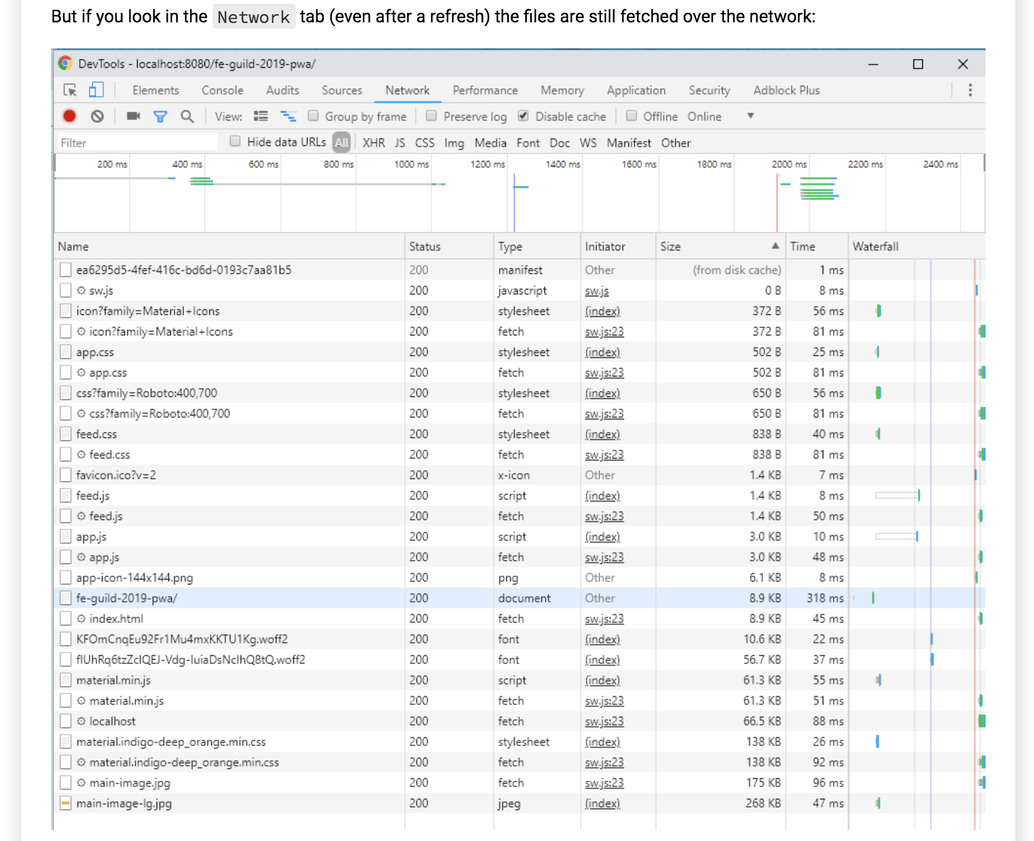

Slide 41
Add this in sw.js
The reason is that the cache is primed and ready to go, but we are not reading assets from it. In order to do that we need to add the code in the next listing to our Service Worker in order to start listening to the fetch event.
self.addEventListener('fetch', event => {
console.log('[Service Worker] Fetching something ....', event);
event.respondWith(
caches.match(event.request)
.then(response => {
if (response) {
console.log(response);
return response;
}
return fetch(event.request);
})
);
});
We are checking if the incoming URL matches anything that might exist in our current cache using the caches.match() function. If it does, return that cached resource, but if the resource doesn't exist in the cache, continue as normal and fetch the requested resource.

Slide 42
If multiple "fetch events" in SW.js, the first "fetch event" is always used.
So always use only 1 fetch event in the SW.js

Slide 43
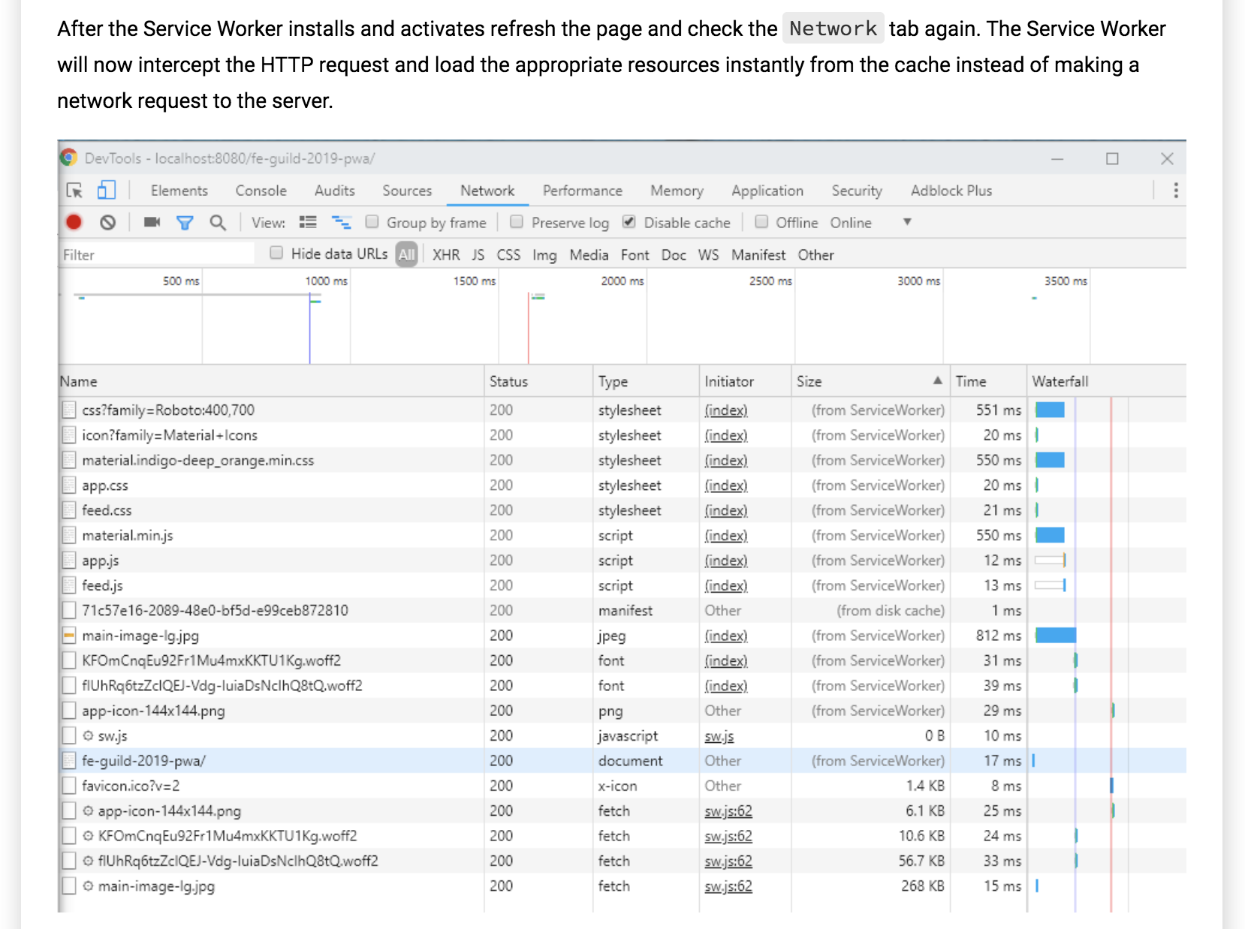

Slide 44
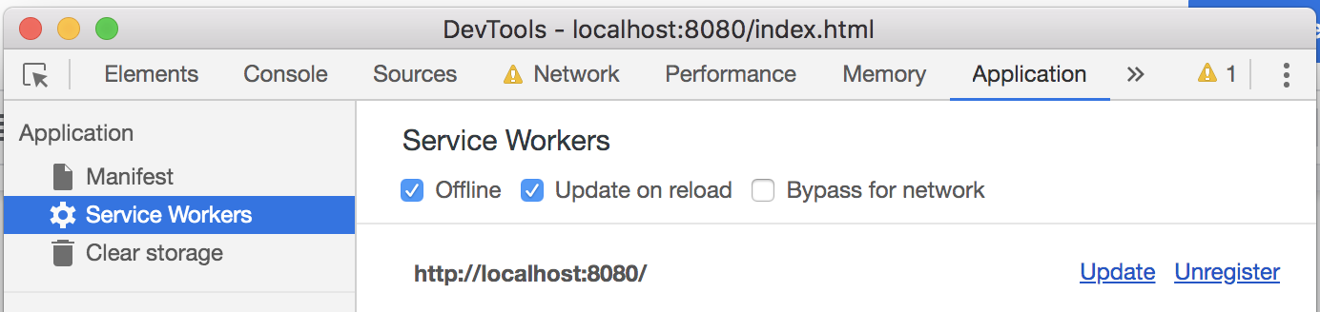
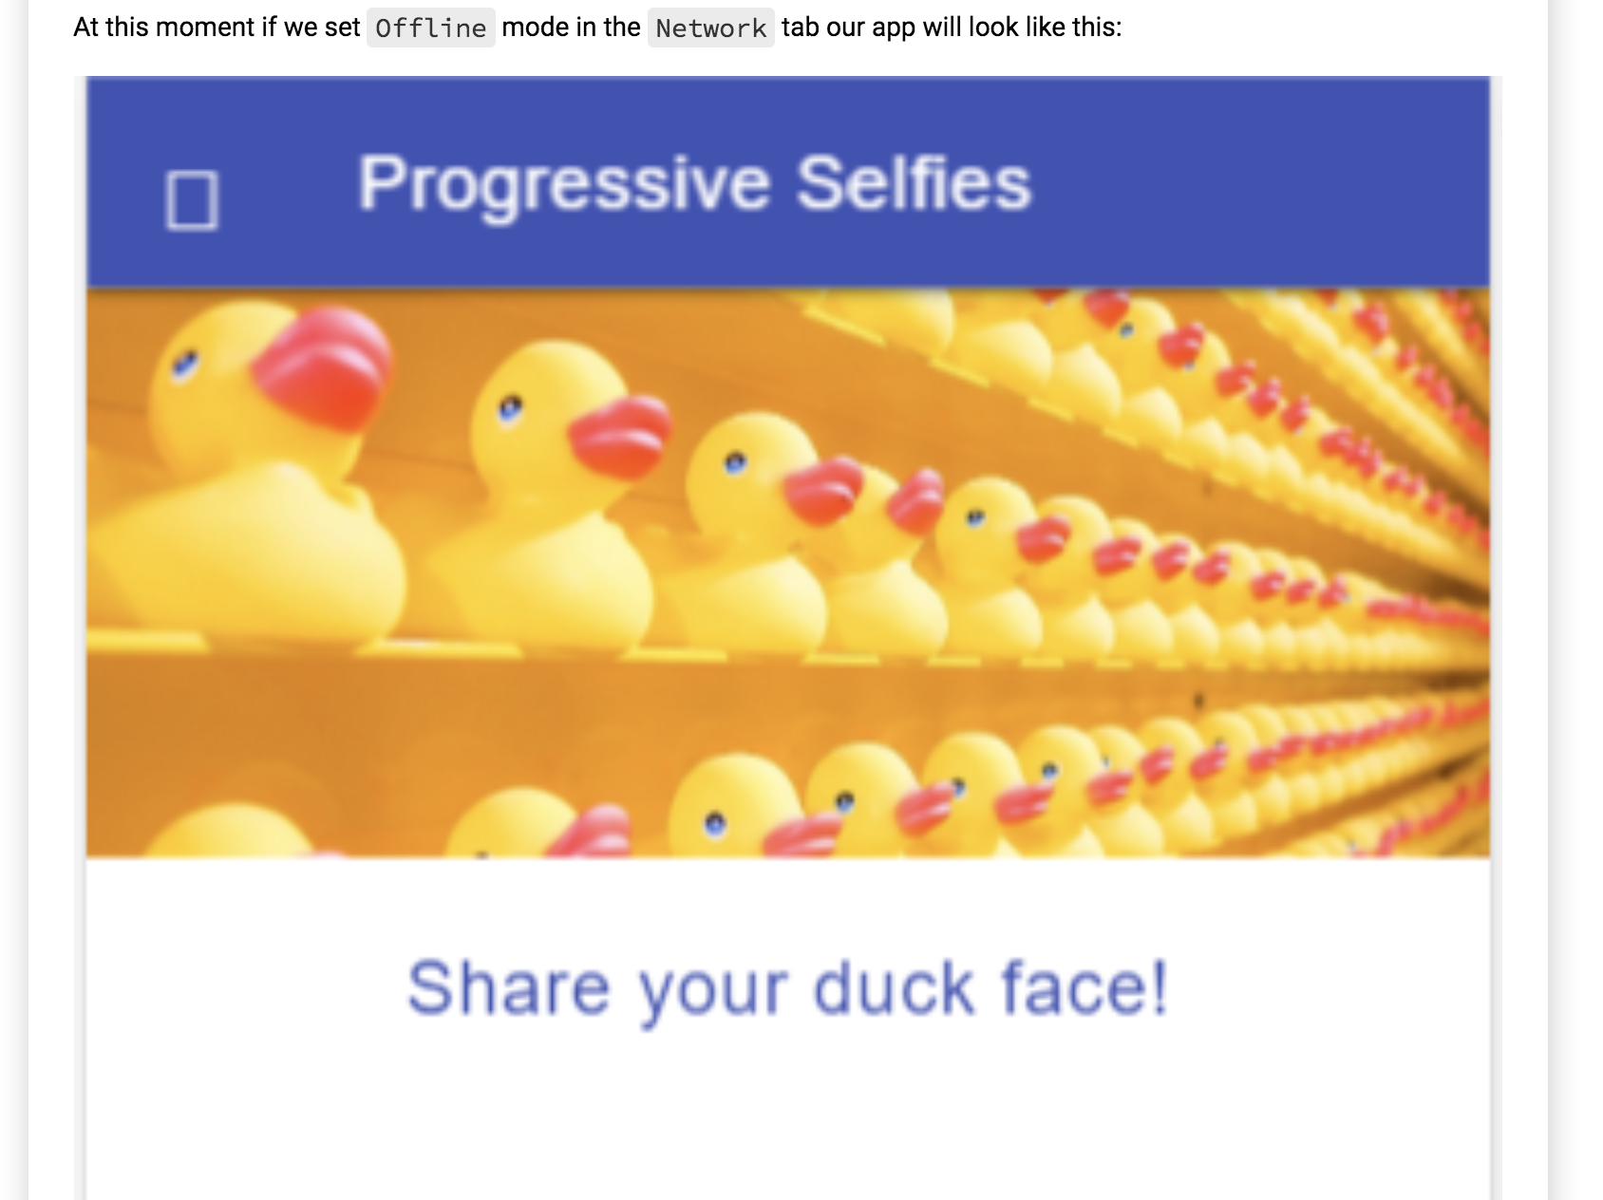
Set your PWA offline

Slide 45
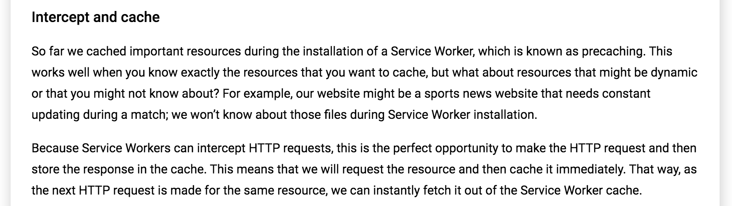

Slide 46
Add this in sw.js
// Add a new cache for dynamic content
const CACHE_DYNAMIC_NAME = 'dynamic';
self.addEventListener('fetch', event => {
console.log('[Service Worker] Fetching something ....', event);
event.respondWith(
caches.match(event.request)
.then(response => {
if (response) {
return response;
}
// Clone the request - a request is a stream and can be only consumed once
const requestToCache = event.request.clone();
return fetch(requestToCache)
.then(response => {
if (!response || response.status !== 200) {
return response;
}
// Again clone the response because you need to add it into the cache
const responseToCache = response.clone();
caches.open(CACHE_DYNAMIC_NAME)
.then(cache => {
cache.put(requestToCache, responseToCache);
});
return response;
})
})
.catch(error => console.log('[Service Worker] Dynamic cache error.', error))
);
});
The code above caches the resource fetched from the network and returns it back to the page. If we reload the page, the resources cached in both caches will be matched.

Slide 47
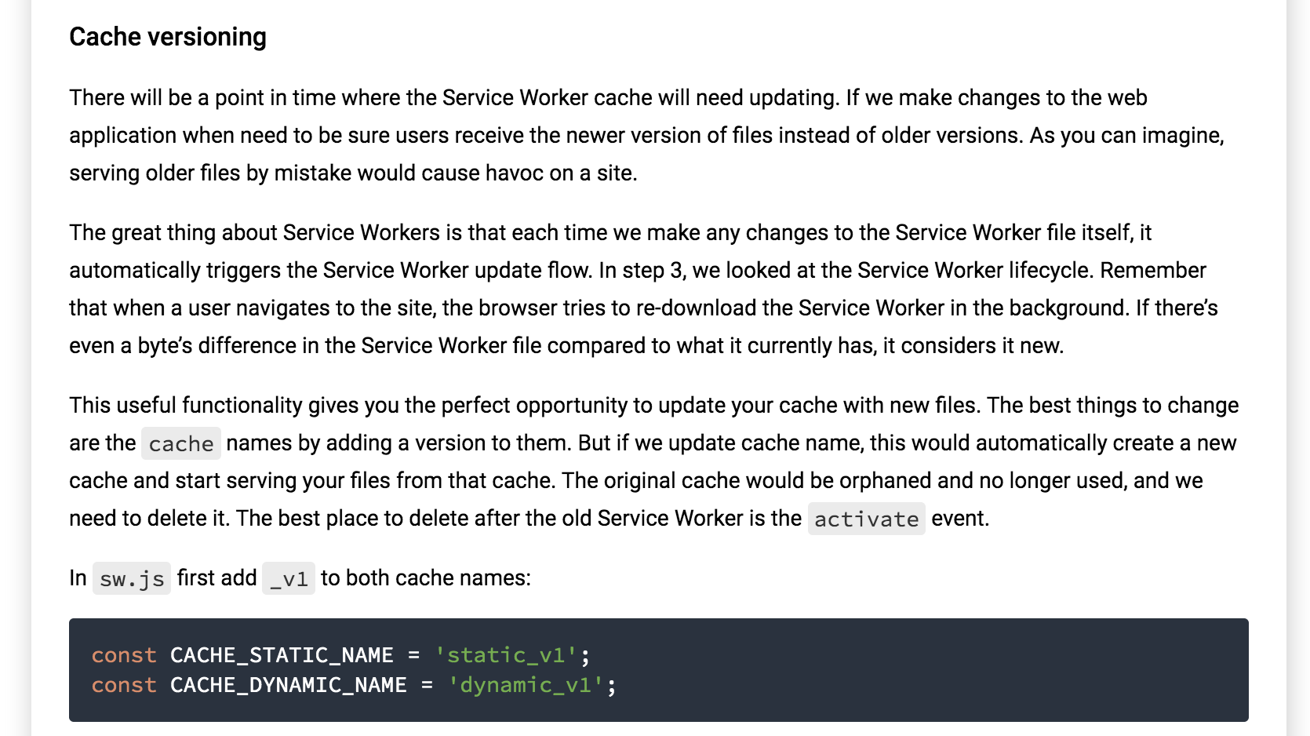

Slide 48
Add this in sw.js
self.addEventListener('activate', event => {
console.log('[Service Worker] Activating Service Worker ...', event);
event.waitUntil(
caches.keys()
.then(cacheNames => {
return Promise.all(cacheNames.map(cacheName => {
if (cacheName !== CACHE_STATIC_NAME && cacheName !== CACHE_DYNAMIC_NAME) {
console.log('[Service Worker] Removing old cache.', cacheName);
return caches.delete(cacheName);
}
}));
})
.then(() => {
console.log('[ServiceWorker] Claiming clients');
return self.clients.claim();
})
);
});

Slide 49
Custom offline page
Even if we cache the help page when we navigate to it, we may happen to become offline before it gets cached, and in this case, we get the browser's default offline page. To account for this case, we can create our own offline.html page:
Duplicate the index.html file and name the duplicate offline.html
Replace the main tag with:
<main class="mdl-layout__content mat-typography">
<div class="page-content">
<h5 class="text-center mdl-color-text--primary">We're sorry, this page hasn't been cached yet :/</h5>
<p>But why don't you try one of our <a href="/fe-guild-2019-pwa/">other pages</a>?</p>
</div>
</main>

Slide 50
Add the offline.html to the list of files to be precached.
Increase the version of the static cache.
Then inside the fetch handler replace the:
.catch(error => console.log('[Service Worker] Dynamic cache error.', error)));
with:
.catch(error => {
return caches.open(CACHE_STATIC_NAME)
.then(cache => {
if (event.request.headers.get('accept').includes('text/html')) {
return cache.match('/fe-guild-2019-pwa/offline.html');
}
});
})
Finally refresh the application, manually delete the help-page entry in the dynamic cache if you have it.
Go offline and try to navigate to the help page. You should see the new offline page being displayed.

Slide 51
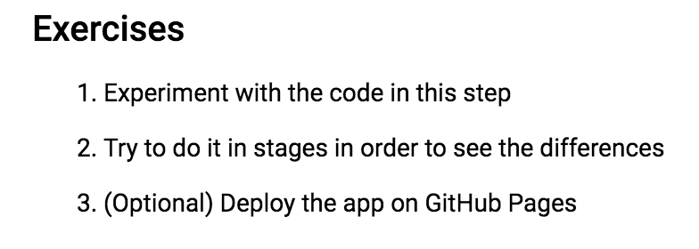

Slide 52

Solution

